Slide 1
Potential and pitfalls. Contemporary approaches to language testing.
Alex Thorp
Academic Support Specialist
Trinity College London
English qualifications for real-world communication

Slide 2
Overview
Notes:
Ways of thinking ; ways of learning – comms and collaboration (21st C skills)

Slide 3
Overview
What do tests do - reflections
Developments in assessment
Role of assessment literacy for teachers
What students need
Assessing assessment
Trinity response
Q&A
Notes:
Ways of thinking ; ways of learning – comms and collaboration (21st C skills)

Slide 4
The role of assessment Why examine?
Proficiency
Achievement
Diagnostic
Whose perspective?
Notes:
These are the three main categories of testing, with Placement being a fourth although this can be included under diagnostic.
Problem is this is a traditional perspective from view point of student…

Slide 5
The role of assessment True or false
Assessment practices can inhibit best teaching practices
Test preparation can inhibit learning
Students can be demotivated by assessment practices
Assessment provides inadequate feedback compared to student input
Notes:
Ask participants to decide if true or false – all can be true - these are some of the pitfalls of poor assessment application

Slide 6
The potential of assessment.
Summative assessment can…..
-improve the quality of teaching?
-aid language learning?
-aid wider skill (transferable) development?
-motivate students?
-provide high-stakes outcomes for students?
-provide a range of feedback measures?
Notes:
Depending dynamic cd ask to discuss general opinion as to criteria listed – objective is to raise a degree of awareness as to the wider implications of test choice at an institutional level.

Slide 7
The potential of assessment.
Summative assessment can…..
Notes:
Firstly establish testing is a broad church – one categorisation:
Assessment – informal, related to teaching and feedback focused usually formative
Testing – Semi-formal classroom based, local construct
Examination – higher stakes, formal and usually summative
Brainstorm why we test – gather responses from floor
Proficiency – what is the learners language level
Diagnostic – what are strengths and weaknesses – usually for remedial attention – (Includes Placement – where so they fit)
Achievement – how much has S learnt

Slide 8
The potential of assessment.
A sample response
Is this acceptable?
Notes:
This gives one example of an opinion as to testing – do you agree???

Slide 9
Role of assessment The effect of exams
Learning
Assessment
Notes:
Increasing importance over time of the impact on the student of the assessment at all stages and an increasingly holistic understanding of role – where the Ss learning is at centre of validity argument.
Therefore testing goes way beyond Proficiency, Diagnostic or Achievment – becomes a bedrock of educational system

Slide 10
Pitfalls in testing Dangers
Bias test score and test skills at the expense of communicative competence or positive washback
Test skills
Test score as priority
Notes:
Danger to be caught in the past – based in traditional teaching methodology

Slide 11
Developments in validity theory Consequential validity
Systemic validity (Overall)
Fredericksen & Collins
Consequential validity (Impact)
Messick
Washback (Effect)
Bailey
Notes:
Increasing importance over time of the impact on the student of the assessment at all stages and an increasingly holistic understanding of role – where the Ss learning is at centre of validity argument
Systemic validity …when a test induces in the education system curricular and instructional changes that foster the development of the cognitive skills that the test is designed to measure.
(Fredericksen & Collins, 1989)

Slide 12
Developments in validity theory Washback – nothing new
If a test has positive washback, ‘there is no difference between teaching the curriculum and teaching to the test’.
(Weigle & Jensen, 1997, p. 205)
Tests can be a powerful, low-cost means of influencing the quality of what teachers teach and what learners learn at school.
(Heyneman & Ransom, 1992)
Notes:
These are the three main categories of testing, with Placement being a fourth although tis can be included under diagnostic.

Slide 13
Changing face of assessment Learning and assessment alignment
Learning
Assessment
Notes:
Increasing importance over time of the impact on the student of the assessment at all stages and an increasingly holistic understanding of role – where the Ss learning is at centre of validity argument.
Therefore testing goes way beyond Proficiency, Diagnostic or Achievment – becomes a bedrock of educational system

Slide 14
The evolution of language assessment
Drivers
Language assessment
SLA / SLL theory
Neuro-linguistics
Contiguous disciplines
Evidence-based practice
Notes:
There have been many influences on language assessment that have led to it’s continued evolution
1:Second Language Learning and Second Language Acquisition theories: A completely separate discipline although role of assessment increasingly understood as having the potential to have a marked influence of enhancing learning effectiveness if cognitive processes and cultural settings are appropriate (contextual validity).
-Universal grammar theorists
-Connectivist / Constructivist theorists
-LAD and Maximum exposure hypothesis
Etc…
2: Neuro linguistics and cognitive neurology – marked advancesin how we know languages are learnt, empirical studies that demonstrate choral assemblies of neural pathways embedding vocabulary etc. Has informed SLA theory and in turn we influenced assessment – notably role of aligned cognitive processes, affective filters (neurotransmitters), processing memory atrophy and memory manipulation (ACS), building onto established networks, taxonomy of thinking order (LOTS), visual and spatial representation (See article on Conitive Classroom – 2014)
3: Contiguous disciplines, those around language, have made considerable developments that influence language and testing, notably the social sciences and psychology, has highlighted role of culture and individual agency in testing.
4:Evidence-based practice has driven educational reform as tradition and practice norms / conormity are no longer adequate grounds to justify practice – in an individualised paradigm of the information age we need empirical evidence for practice. John Hattie and Jeoff Petty particularly, in Evidence-based teaching and later work by Marzano. Underlined constructivist testing and motivational influences

Slide 15
How changes influence assessment Validity theory
Test taker
Cognitive processes
Resources
Consequences
Contextual parameters
Placing the individual test taker at the heart of the language testing agenda.
Test taker
Notes:
At the centre of modern validity theory is the need to place the test taker at the centre of the test – not a wider disassociated measure of content knowledge… All of the above need to be taken from perspective of the test taker from the very development.
Cognitive processes employed in task performance – stages of cognition that underlie performance
Resources – language competence, background knowledge
Contextual parameters – task purpose, timing, knowledge how will be assessed
Added – consequences in regard to consequential validity and criterion-related validity (socio-cognitive framework)
Placing the individual test taker at the heart of the language testing agenda. Quote from O’Sullivan 2010 pg3

Slide 16
The evolution of our students Digital native or digital immigrant? SCREENAGERS
Changes in regions related to attention
Parietal cortex: orientation of attention
Frontal lobe: sustaining attention
Anterior cingulate: regulation of attention
Not atrophy – further connectivity
Digital natives process information differently.
21st Century Skills?
Is this reflected in how we teach?
Is this reflected in how we test?
Notes:
Why does feedback work in the language classroom?
Feedback works for the simple reason that a neural assembly or pathway that is repeatedly triggered establishes additional connections and, with appropriate review and feedback, can be endorsed and strengthened exponentially.
Review and recall questions corroborate and reinforce neural pathways and assemblies compounding the learning. Neural pathways that are not stimulated can atrophy, this is the brain’s way of streamlining its content.
Greenfield - Beavelier

Slide 17
What students need to succeed What we know
What kind of test generates
positive washback?
Language Skills
Transferable Skills
Study Strategies
Notes:
Ask pairs to consider / brainstorm from group what International Ss need to succeed – academically etc…
Q: if the learner is at the centre of the testing system and validity argument we need to ask what students need to develop in order to succeed holistically and then ask if this is reflected in the test.

Slide 18
What students need to succeed Language skills = Communicative competence
Linguistic
competence
Socio-linguistic
competence
Communicative
Competence
Discourse
competence
Strategic
competence
Bachman & Palmer (2010): communicative competence model
Notes:
Go through the skills that are necessary Language Skills

Slide 19
What students need to succeed
Language Skills
Transferable Skills
Study Strategies
Notes:
Ask pairs to consider / brainstorm from group what International Ss need to succeed – academically etc…
Q: if the learner is at the centre of the testing system and validity argument we need to ask what students need to develop in order to succeed holistically and then ask if this is reflected in the test.

Slide 20
What students need to succeed Transferable skills
Tony Wagner
Expert in Residence Innovation Lab of Harvard
Critical thinking & problem solving
Collaboration and leading by influence
Agility and adaptability
Initiative and entrepreneurship
Effective oral and written communication
Accessing and analyzing information
Curiosity and imagination
Notes:
Over 2500 discipline specific academic papers published on Study skills from a DeepDyv search referencing requisite study skills

Slide 21
What students need to succeed
Language Skills
Transferable Skills
Study Strategies
Notes:
Ask pairs to consider / brainstorm from group what International Ss need to succeed – academically etc…
Q: if the learner is at the centre of the testing system and validity argument we need to ask what students need to develop in order to succeed holistically and then ask if this is reflected in the test.

Slide 22
What students need to succeed Study strategies
Note-taking
Summarising
Synthesising
Sourcing relevant data across texts
Planning
Self-checking and self-evaluation
Deducing and inferring
Study Strategies
Notes:
Ask Ts What do they do – English Ts – but learning a language is so much more
You need a raft of cognitive skills to acquire language and these need to be tested.

Slide 23
What students need to succeed What we now know
In an ideal world a test would reflect….
Language Skills
Transferable Skills
Study Strategies
…..placing the test taker at the
centre of the test.
Notes:
The point is here that, ideally, a test should reflect a range of skills that go beyond linguistic, this reflects the wider cognitive skill engagement that we know are required to acquire language. These three skill sets give a background to the skill-sets that are developed when preparing for ISE. It is important to note that this wider skill set is not assessed as such, but rather developed trough an exam like ISE.

Slide 24
It’s not all in the assessment Test application
ILOs
=
Objective
Teaching
=
Activation
ATs
=
Assessment
Positive washback is said to result when a testing procedure encourages ‘good’ teaching practice. (Taylor:2016)

Slide 25
Role of assessment literacy The type of questions teachers should be asking
What is Assessment literacy?
Assess your assessments. Tests should…
Test what they claim to test
Aligned to the intended learner outcome (ILO)
Relevant to the personalised context of learner
Reflect skills based in real-world practice
Consider the outcomes of the test
Be trustworthy - consistent with every student
Learning
Assessment
Then learning can be enhanced.
Notes:
Increasing importance over time of the impact on the student of the assessment at all stages and an increasingly holistic understanding of role – where the Ss learning is at centre of validity argument.
Therefore testing goes way beyond Proficiency, Diagnostic or Achievment – becomes a bedrock of educational system

Slide 26
Role of assessment in education Assessment literacy empowers teachers
Assess your assessments. Tests should…
Test what they Claim to test
Aligned to the intended learner outcome (ILO)
Relevant to the personalised context of learner
Reflect skills based in Real-world practice
Consider the Outcomes of the test
Be Trustworthy - consistent with every student
Learning
Assessment
Notes:
Increasing importance over time of the impact on the student of the assessment at all stages and an increasingly holistic understanding of role – where the Ss learning is at centre of validity argument.
Therefore testing goes way beyond Proficiency, Diagnostic or Achievment – becomes a bedrock of educational system

Slide 27
Role of assessment in education Assessment literacy empowers teachers
Assess your assessments. Tests should…
Claim
Aligned
Relevant
Real-world
Outcomes
Trustworthy
Construct validity
Constructive alignment
Authenticity – Bias for best
Cognitive validity
Consequential validity
Reliability
Learning
Assessment
Notes:
Increasing importance over time of the impact on the student of the assessment at all stages and an increasingly holistic understanding of role – where the Ss learning is at centre of validity argument.
Therefore testing goes way beyond Proficiency, Diagnostic or Achievment – becomes a bedrock of educational system

Slide 28
The potential of assessment.
Summative assessment can…..
Assessment literacy
Notes:
Firstly establish testing is a broad church – one categorisation:
Assessment – informal, related to teaching and feedback focused usually formative
Testing – Semi-formal classroom based, local construct
Examination – higher stakes, formal and usually summative
Brainstorm why we test – gather responses from floor
Proficiency – what is the learners language level
Diagnostic – what are strengths and weaknesses – usually for remedial attention – (Includes Placement – where so they fit)
Achievement – how much has S learnt

Slide 29
The potential of assessment.
Summative assessment can…..
Notes:
Firstly establish testing is a broad church – one categorisation:
Assessment – informal, related to teaching and feedback focused usually formative
Testing – Semi-formal classroom based, local construct
Examination – higher stakes, formal and usually summative
Brainstorm why we test – gather responses from floor
Proficiency – what is the learners language level
Diagnostic – what are strengths and weaknesses – usually for remedial attention – (Includes Placement – where so they fit)
Achievement – how much has S learnt

Slide 30
Are tests doing what they need to? Contemporary language examinations
When did you last do any of these?
Describe a picture
Talk about [2 out of 3] pictures for one minute
Talk about an experience (monologue to a computer)
Speak about a topic you are given after one minute’s thinking time (for that topic)
Listen and repeat sentences
Listen and answer multiple choice questions about what you’re listening to
Listen to a recording and select the correct answers
Listen and write the correct answers
Read aloud – words or sentences (to a computer)
Read and select true, false or not given
Transform sentences using knowledge of grammar/syntax
Write about, and compare, pictures, graphs/charts
…when would learners?
…do they reflect contemporary assessment?

Slide 31
Trinity College London
In an ideal world a test would reflect….
Language Skills
Transferable Skills
Study Strategies
…..placing the test taker at the
centre of the test.
Notes:
The point is here that, ideally, a test should reflect a range of skills that go beyond linguistic, this reflects the wider cognitive skill engagement that we know are required to acquire language. These three skill sets give a background to the skill-sets that are developed when preparing for ISE. It is important to note that this wider skill set is not assessed as such, but rather developed trough an exam like ISE.

Slide 32
Trinity Int. ESOL Qualifications Academic background
Background & origins
REF
CRELLA
CEFR
ALTE
Banded not sliding
Integrated
Notes:
Highlight that Trinity worked in partnership with CRELLA at the University of Bedfordshire, with our internal academic team and input form the team at Lancaster, to produce a contemporary exam that relates to the skill sets detailed.
Go through the key points – detailed below. Overall, these are key points behind the development of ISE .
CRELLA - research and pre-testing. World-leading, as per REF
REF - the Research and Excellence Framework 2014: This validates CRELLA as a world leader in test production
Our research submission as a whole was also rated as excellent. Overall the REF Panel ratings for CRELLA were:
45% 4* world leading
33% 3* internationally excellent
You can see the full result here. Our 45% 4* rating was higher in this same Unit of Assessment than the ratings awarded to Oxford, Cambridge, Edinburgh, Manchester, Lancaster and a number of other major universities, which demonstrates our strength in this area. The Times highlighted our work as a 'cause célèbre', reporting that:
...the nine researchers in English at Bedfordshire University produced a higher proportion of top-rated research than the 88 entrants from Oxford Times 18/12/2014
CEFR - Mapped from, not to, this has important implications for accuracy of calibration (validity) and predictive validity, ISE has not been retrospectively fitted to CEFR therefore is a more accurate measure in that it’s construct based on CEFR level content.
ALTE – Trinity have the Q mark (quality), the highest level of accreditation with ALTE
Integrated – ISE is unique in that it is a truly integrated exam, with discreet assessment of Interactive listening and Reading into Writing.
Banded not sliding – Because iSE is a banded scale and not sliding content and tasks in the exam are more accurately calibrated to the level of the CEFR being assessed. As it is not ‘one size fits all’ there is more comprehensive coverage of the language of the respective CEFR level, creating a more valid exam.

Slide 33
Trinity College London
Trinity Stars
Young Performers in English Award
GESE
Graded Examinations in Spoken English
English qualifications
for real-world communication
ISE
Integrated Skills in English
SEW
Spoken English for Work
TESOL
CertTESOL, TYLEC, DipTESOL…....

Slide 34
A Communicative Pathway
Trinity Stars
GESE 1 | GESE 2 | GESE 3-4 | GESE 5-6 | GESE 7-8-9 | GESE 10-11 | GESE 12
ISE F | ISE I | ISE II | ISE III | ISE IV
SEW B1 | SEW B2-B2+ | SEW C1
Pre-A1
A1
A2
B1
B2
C1
C2
TESOL
Notes:
This slide is to demonstrate that there is a clear ‘Trinity pathway’ of language assessments that progress from Trinity Stars, a group award open to age 3 and above, through to a work focused exa and further still, to TESOL qualifications.

Slide 35
Trinity College London Speaking & Listening module
Integrated Skills in English
Topic task
Collaborative task
Conversation task
Independent listening task
Candidate prepares ANY topic for discussion with the examiner
A prompt sets the scene for a test-taker led discussion
Examiner selects topic from a list and starts a conversation
Factual listening text(s); takes notes before reporting orally to the examiner*
Notes:
Highlight that:
Topic task = Personalised. Candidates use a range of transferable skills including preparation, self correction, research,
Collaborative task = Interactive. Assessing how well candidates can communicate in real like – this is strategic competences and survival strategies
Conversation task = Academic topical conversation. Candidates can research topic and explore through a meaningful conversation
Note that there are no scripts with any Trinity ESOL exam as they are based on spontaneous, real-life communication.
Listening*- note that this is different at different levels and only at certain parts of the listening task can notes be taken.

Slide 36
Trinity College London Reading & Writing module
Integrated Skills in English
Academic/subject-based texts. Questions from extensive to intensive
Long reading
Multi-text reading
Reading into writing
Extended writing
Reading across texts - contemporary genres, including infographics, blogs, articles – calling upon digital literacies
Includes a summary of all texts which is springboard to subsequent reading task
Planning, checking, using texts to answer a question
Reflects academic skills, encourages language of grade
Notes:
Highlight some of the key features of the reading into Writing
Long reading – academic text of the sort students will be familiar with.
Multi-text reading – contemporary text types using those that students are familiar with. Bringing into play a range of digital literacies, including reading strategies that students would use when surfing the net. Speed-reading, rapid word recognition etc. Note that the last 5 questions ask the candidate to create a summary of all texts, bringing into use reading across all texts and summarising.
Reading into Writing – Trinity have an explicit subjective rating scale that assesses how well a candidate adapts reading input into a productive expression of language. This truly integrated approach reflects real-life use of language
Extended Writing – A longer free-writing task with questions designed to encourage use of the language of the grade.

Slide 37
Summary Assessment literacy empowers teachers
Learning
Assessment
Notes:
Increasing importance over time of the impact on the student of the assessment at all stages and an increasingly holistic understanding of role – where the Ss learning is at centre of validity argument.
Therefore testing goes way beyond Proficiency, Diagnostic or Achievment – becomes a bedrock of educational system

Slide 38
Summary
Why we test - reflections
Developments in assessment theory
Role of assessment literacy for teachers
What students need
Assessing assessment
Trinity response
Q&A
Notes:
Ways of thinking ; ways of learning – comms and collaboration (21st C skills)

Slide 39
Trinity College London
Q&A
Any Questions?
Notes:
Thank you for joining us

Slide 40
Potential and pitfalls in assessment
Alex Thorp
Academic Support Specialist
alex.thorp@trinitycollege.com
Trinity College London
English qualifications for real-world communication

Slide 41
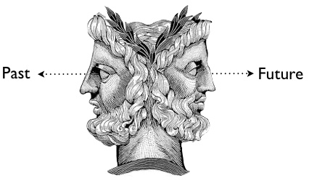
A brief future of… testing.
Application of contemporary theory
Personalised
Authentic task
Transferable skills
Cognitive / Contextual validity
Positive washback
Educational programme support
CLIL compatibility
Content focus
Test-skill bias
Focus on score
Generalised
Discreet item grammar
Negative washback
Notes:
Janus (/ˈdʒeɪnəs/; Latin: Ianus, pronounced [ˈjaː.nus]) is the god of beginnings, gates, transitions,
Education is left behind and failing to keep up with changes in culture and society

Slide 42
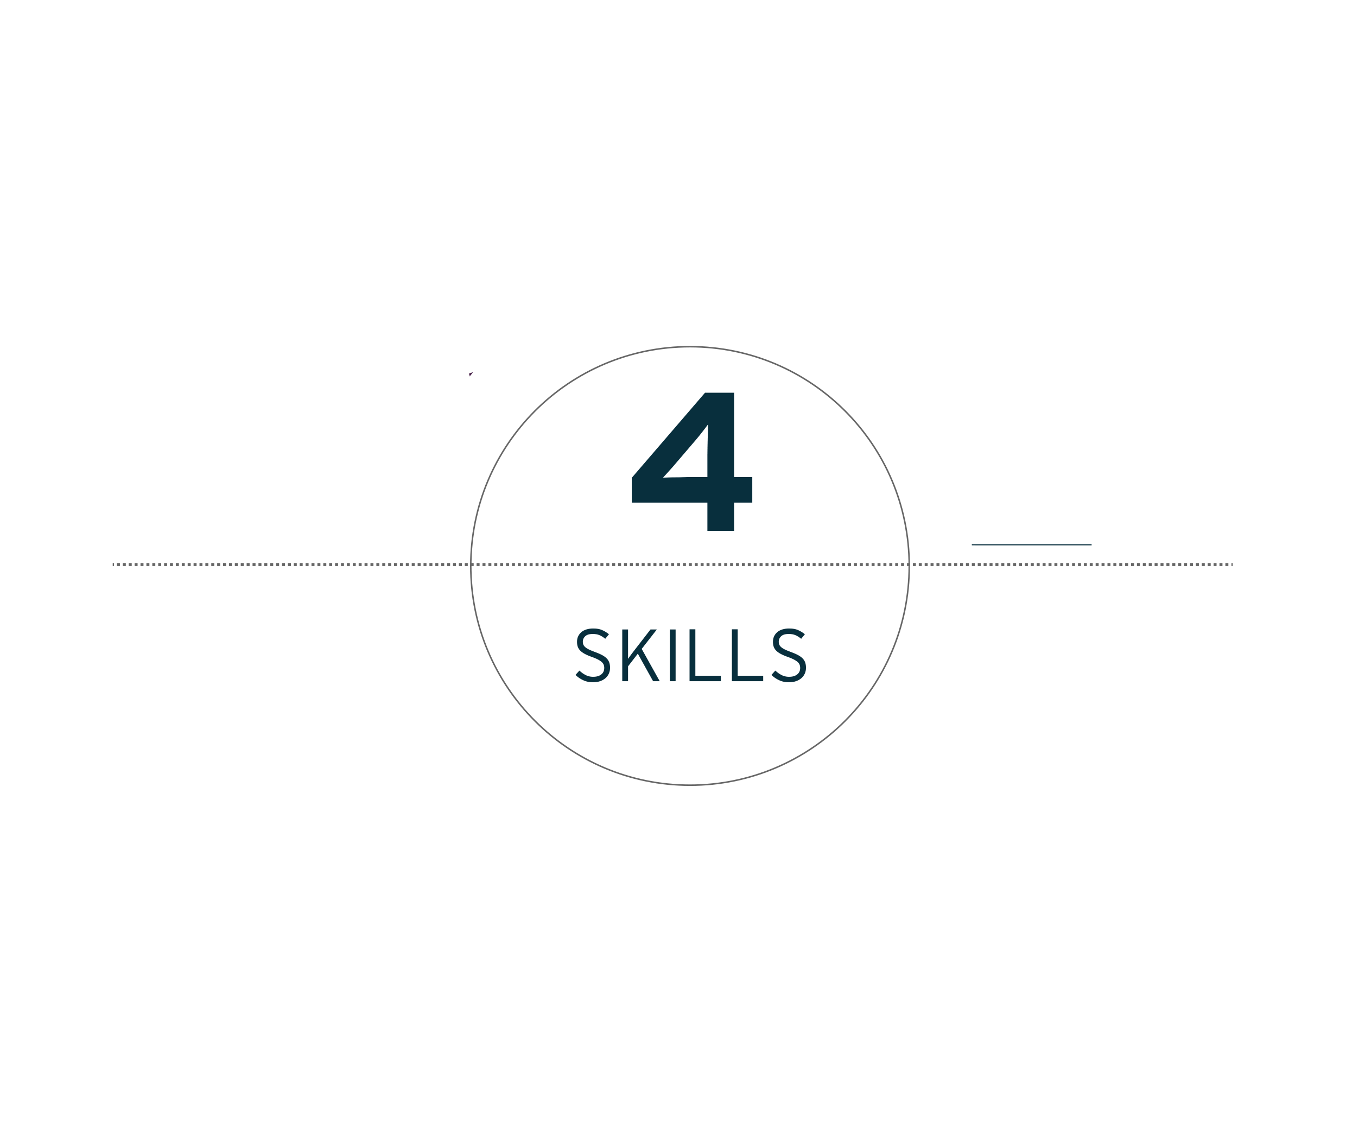
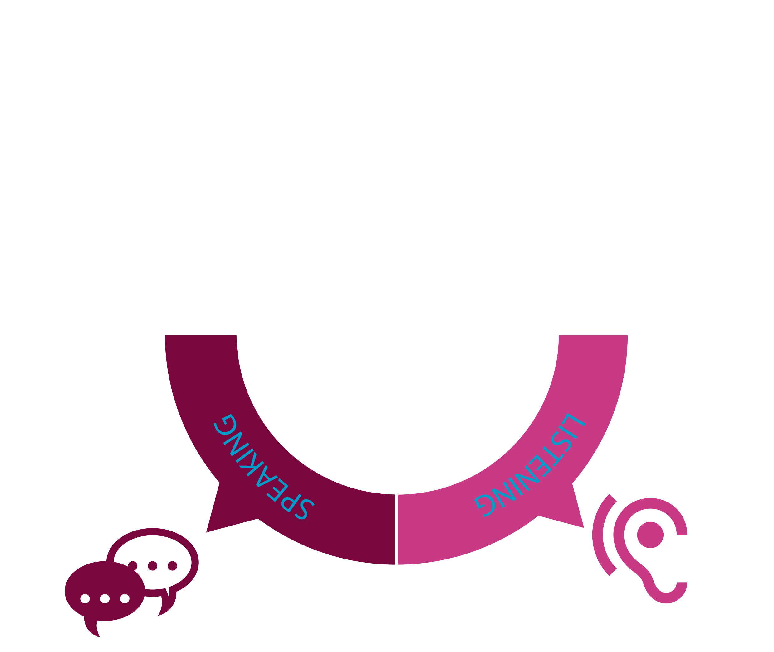
ISE:
Integrated Skills in English

Slide 43
INIS, Trinity College London & ISE
Trinity ISE – revised 2015
An Integrated Skills exam
The ISE
ISE III
C1
ISE I
B1
ISE II
B2
ISE Foundation
A2
Reading & Writing
4 tasks with the same structure across all four levels:
2x Reading tasks, 1x Reading into writing task, 1x Writing task
2 hours
Speaking & Listening
2x Speaking tasks
2x Listening tasks
13 minutes
2x Speaking tasks
2x Listening task
18 minutes
3x Speaking tasks
1x Listening task
20 minutes
3x Speaking tasks
1x Listening task
25 minutes

Slide 44
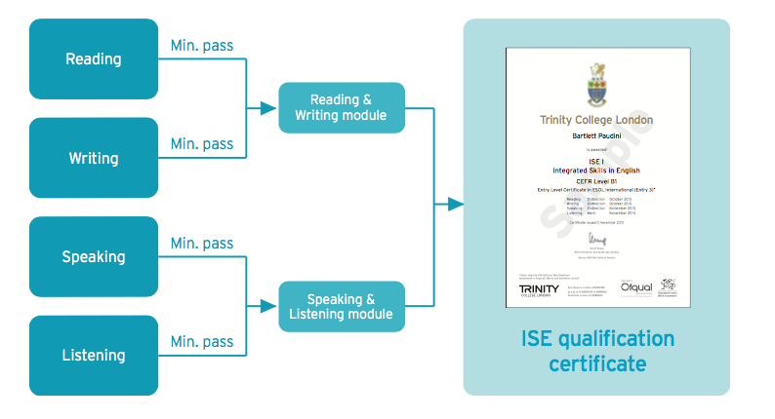
Trinity College London ISE Overview
2 modules, 1 qualification
Distinction
Merit
Pass
Fail

Slide 45
Languages in the past…..
Notes:
Language learning was very different in the past!
They were the opening lines of…. Hard Times – Dickens “Now, what I want is FACTS”
Everything has changed!

Slide 46
A brief history of… testing!
Content
Capability
<1850
1877
1913
1972
2001
2015>
Notes:
Go through key dates in testing, if appropriate brainstorm facts relating to dates
1850s USA psychometric testing measured qualities and indications of underlying skills
1877 Trinity started examining – actually in Music (Monk organ playing etc…)
1913 First international English language exam – Camb prof (x3 all failed) – Shift to CONTENT
1972 Hymes coined phrase Communicative competence – changed SLA and Test theory – many academic iterations
2001 Publication of CEFR referenced to SLA theory and ISE first exam mapped from CEFR, based on Communicative Competence
2015 – Revised ISE launched with comprehensive application of Socio-Cognitive Validity Framework via CRELLA
Highlight that testin is unrecognisable to 20 years ago – informed by cognitive neurology and neuro-linguistics assessment now sits at the heart of learning.

Slide 47
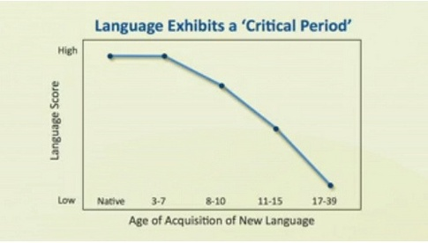
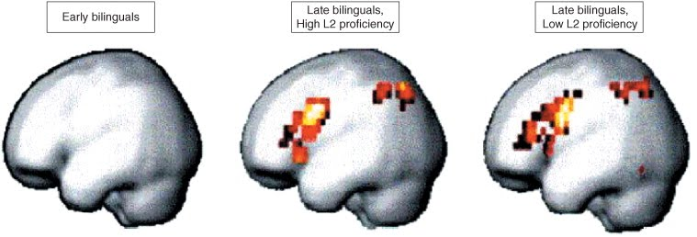
The evolution of language assessment
Examples of development
Universal grammar - predisposition
Maximum Exposure Hypothesis
Constructivist to connectomics
Critical Period Hypothesis
SLA / SLL theory
Notes:
These images show brain activity during grammatical processes; comparing the individuals first language to the second.
Three different groups of languages and different ages were used for this study.
The left image is showing that early bilingual engaged in both languages with the same neural structures and that there was no difference in activation areas in the brain.
The middle and right images are showing that in adults, regardless of how proficient they are in the second language, that the brains of these adults engage in more neural areas, both frontal and parietal.
These results show the effect of age on the acquisition of a second language and the grammatical processes.

Slide 48
Trinity College London Speaking & Listening module
ISE Speaking & Listening
 | ISE F | ISE I | ISE II | ISE III
CEFR level | A2 | B1 | B2 | C1
Topic task | 4 minutes | 4 minutes | 4 minutes | 8 minutes
Collaborative task | - | - | 4 minutes | 4 minutes
Conversation task | 2 minutes | 2 minutes | 2 minutes | 3 minutes
Independent listening task/s | 6 minutes | 10 minutes | 8 minutes | 8 minutes

Slide 49
Trinity College London & ISE
When do you speak without listening?
When do you write without reading?
Communicative competence requires assessment
that tests skill integration.

Slide 50
Trinity College London Reading & Writing module
ISE Reading & Writing
 | ISE F | ISE I | ISE II | ISE III
Time | 2 hours
Task 1 | Long reading 300 words 15 questions | Long reading 400 words 15 questions | Long reading 500 words 15 questions | Long reading 700 words 15 questions
Task 2 | Multi-text reading 3 texts 300 words 15 questions | Multi-text reading 4 texts 400 words 15 questions | Multi-text reading 4 texts 500 words 15 questions | Multi-text reading 4 texts 700 words 15 questions
Task 3 | Reading into writing 70-100 words | Reading into writing 100-130 words | Reading into writing 150-180 words | Reading into writing 200-230 words
Task 4 | Extended writing 70-100 words | Extended writing 100-130 words | Extended writing 150-180 words | Extended writing 200-230 words

Slide 51
Trinity College London Reading & Writing module
Integrated Skills in English
Academic/subject-based texts. Questions from extensive to intensive
Long reading
Multi-text reading
Reading into writing
Extended writing
Reading across texts - contemporary genres, including infographics, blogs, articles – calling upon digital literacies
Includes a summary of all texts which is springboard to subsequent reading task
Planning, checking, using texts to answer a question
Reflects academic skills, encourages language of grade
Notes:
Highlight some of the key features of the reading into Writing
Long reading – academic text of the sort students will be familiar with.
Multi-text reading – contemporary text types using those that students are familiar with. Bringing into play a range of digital literacies, including reading strategies that students would use when surfing the net. Speed-reading, rapid word recognition etc. Note that the last 5 questions ask the candidate to create a summary of all texts, bringing into use reading across all texts and summarising.
Reading into Writing – Trinity have an explicit subjective rating scale that assesses how well a candidate adapts reading input into a productive expression of language. This truly integrated approach reflects real-life use of language
Extended Writing – A longer free-writing task with questions designed to encourage use of the language of the grade.

Slide 52
A brief history of…
testing!
Content
Capability
<1850
1877
1913
1972
2001
2015>
Notes:
Go through key dates in testing, if appropriate brainstorm facts relating to dates
1850s USA psychometric testing measured qualities and indications of underlying skills – Galton 1879
1877 Trinity started examining – actually in Music (Monk organ playing etc…)
1913 First international English language exam – Camb prof (x3 all failed) – Shift to CONTENT
1972 Hymes coined phrase Communicative competence – changed SLA and Test theory – many academic iterations
2001 Publication of CEFR referenced to SLA theory and ISE first exam mapped from CEFR, based on Communicative Competence
2015 – Revised ISE launched with comprehensive application of Socio-Cognitive Validity Framework via CRELLA
Highlight that testin is unrecognisable to 20 years ago – informed by cognitive neurology and neuro-linguistics assessment now sits at the heart of learning.

Slide 53
Are tests doing what they need to? Contemporary language examinations
When did you last do any of these?
Talk about an experience (in monologue to a computer)
Listen and answer multiple choice questions about what you’re listening to
Read aloud (to a computer)
Listen and repeat sentences
Listen to a recording and select the correct answers
Listen and write the correct answers
Read and select true, false or not given
Speak about a topic you are given after one minute’s thinking time (for that topic)
Talk about [2 out of 3] pictures for one minute
Transform sentences using knowledge of grammar/syntax
Write about, and compare, graphs/charts
…when would students?
…do they reflect 21st century skills?

Slide 54
Language skills – communicative competence
The topic you’ve chosen is: ‘adapting to living in a new country’…. so let’s discuss that [together[]
Linguistic
competence
Socio-linguistic
competence
Discourse
competence
Strategic
competence
Bachman & Palmer (2010): communicative competence model

Slide 55
Trinity College London Summary
Potential and pitfalls in testing.
And teachers need
the tools to evaluate tests
to be able to develop or choose tests with potential to enhance learning
avoid teaching test-skills and focus on real-world skills
actively engage positive washback
Assessment literacy
Notes:
The point is here that, ideally, a test should reflect a range of skills that go beyond linguistic, this reflects the wider cognitive skill engagement that we know are required to acquire language. These three skill sets give a background to the skill-sets that are developed when preparing for ISE. It is important to note that this wider skill set is not assessed as such, but rather developed trough an exam like ISE.

Slide 56
Role of assessment – motivation Academic background
Extrinsic
Social
Intrinsic
Achievement
What outcome produces
What other people value
Process of doing
Enhance
ego
Key to motivation is to ensure academic activities are meaningful and worthwhile
Notes:
When looking form the perspective of the test taker the role of assessment is also key In relation to motivation, and within an educational context an appropriately constructed test can engage a wide range of motivators as outlined above (See Maslow, C Dweck).

Slide 57
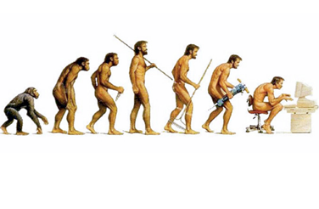
Our educational backdrop
Students of our time
The information
age
‘Brain has evolutionary mandate to exquisitely adapt to environment, ergo, gaming physically alters the brain’ Greenfield 2014
Notes:
Screenagers – brain changing – 6.5hrs daily in front of screens
Enter focus on digital litetacies and
Most jobs our student end up with don’t yet exist

Slide 58
Assessment - Validity
Building a system of assessment
Objective
Learner
Tasks
Scoring
Impact
Construct
Notes:
Complex but as a brief overview we need to ask about a test.
A test can only be valid for it’s stated purpose. Walk trainers through each Q as a stage Q their opinion
Purpose – why – what do I need the test to tell me
Test taker – who am I testing
Construct – What am I testing (latent trait)
Tasks – can only be developed once I have the construct - How do I test – Essential – what are the cognitive processes required to complete
Reliability – How am I scoring - Ask trainers to score an object (apple), then ask why, then give a criterion and repeat
Impact – how does this affect the learner

